Slide 1
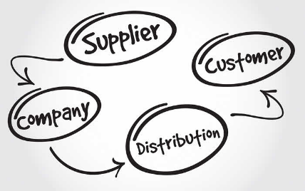
TOPIC 5: PLACE (DISTRIBUTION)
https://www.resultist.com/blog/types-of-sales-distribution-models-capitalizing-on-missed-opportunities

Slide 2
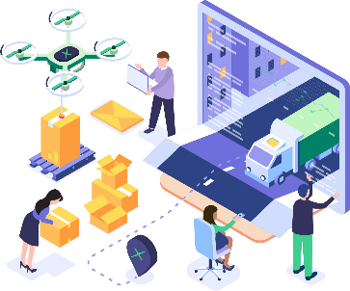
Distribution
Distribution represents “place” in the marketing mix.
It facilitates the flow of goods through the supply chain, helping to move these goods from producers to consumers.
https://www.axelor.com/distribution/

Slide 3
Distribution channel
Marketing (distribution) channel - A large “pipeline” through which products, their ownership, communication, financing and payment, and accompanying risk, flow to the business consumer or final consumer, through the joint effort of all channel members.
Channel members - Sets of interdependent organizations that ease the transfer of ownership as products move from producer to business user or consumer.
Channel members typically:
Buy and sell products.
Negotiate with one another.
Facilitate the change of ownership between buyer and seller while moving the product along the distribution channel.

Slide 4
Activity: Distribution
Watch the video and answer the questions that follow.
https://www.youtube.com/watch?v=G5XTIts7dQk
Note: The “extended marketing mix” is used for the marketing of services, but the core issues in distribution are still applicable to distribution of products. You only need to know the 4Ps.
What is the main objective of distribution?
List 4 key questions that influence distribution decisions.
What is an intermediary? Name 4 types of intermediaries.
What is a the meaning of “multi-channel distribution”?

Slide 5

Functions of distribution
Channels members perform various functions such as:
Division of labour and specialization
Overcoming of discrepancies
Improving contact efficiency
https://www.maersk.com/supply-chain-logistics/warehousing-and-distribution/distribution-services

Slide 6
Channel functions
Division of labour and specialization
Breaking complex tasks into smaller ones, e.g. storage, delivery (division of labour).
Tasks performed by specialists, e.g. overnight delivery (specialisation).
Results in greater efficiency and lower production costs because channel member focuses on what it can do best (specialized).

Slide 7

Channel functions
Overcome 4 types of discrepancies to ensure that the right product is available in the right place at the right time and in the right quantity
Temporal discrepancy
Spatial discrepancy
Discrepancy of quantity
Discrepancy of assortment
https://www.thefreedictionary.com/discrepancy

Slide 8
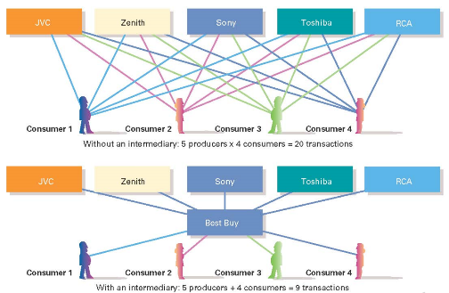
Channel functions (continued)
Provide contact efficiency
Reduces the number of transactions required to get products to consumers and making an assortment of goods available in one location.
https://www.slideshare.net/TheSupplychainniche/chapter-12-marketing-channels-and-supply-chain-management-4270002#:~:text=Providing%20contact%20efficiency%20by%20cutting,goods%20available%20in%20one%20location.&text=Marketing%20channels%20store%20and%20distribute,in%20quantities%20that%20consumers%20desire.

Slide 9
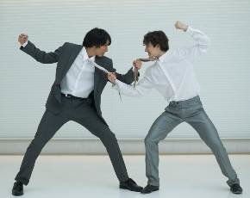
Channel conflict
Channel members may work well together, but sometimes conflict arises.
Two types of conflict:
Horizontal conflict
Vertical conflict
https://www.computerweekly.com/microscope/opinion/Is-channel-conflict-an-inevitable-result-of-innovation

Slide 10
Horizontal channel conflict
Conflict between two or more players at the same level in the distribution channel, e.g. conflict between retailers or between agents or between wholesalers, etc.
Example:
Suppose a toy manufacturer has deals with two wholesalers, each contracted to sell products to retailers in different regions. If one wholesaler decides to branch its operations into the other wholesaler’s region, a conflict will result between the wholesalers. If the toy manufacturer doesn't help solve the problem, its business dealings with both the wholesalers – and the downstream retailers, as well – might be in jeopardy.

Slide 11
Vertical channel conflict
Conflict happens at consecutive levels of the distribution channel, e.g. between the manufacturer and a wholesaler, or between the wholesaler and a retailer.
Example:
If the toy manufacturer discovers its products are arriving at retail stores later than scheduled, a conflict might develop between the manufacturer and the wholesaler responsible for shipping to retailers. At the same time, the retail stores might be in conflict with the wholesaler due to its inability to ship products on time.

Slide 12
Activity: Case study - Scoops Ice Cream
Pretend that you are part of a family business that produces its own ice cream on a premises located close to McDonald’s in Bad Mergentheim. The business has been in operation for a few months only. Up to now, it produced its ice cream in small batches and sold it in 400g tubs, directly from the production point, to anyone who wants to buy the products. Up to now, some of the supermarkets and many consumers, would go to the premises to buy the ice cream.
After someone, not affiliated with the company, sent six tubs of Scoop’s ice cream to a popular talk-show host, she proclaimed on a regional TV show that it was the best ice cream she had ever eaten. This was quickly shared via social media.

Slide 13
Activity: Case study - Scoops Ice Cream
Soon after the broadcast, orders came flooding in, overwhelming your small-batch production schedule and your limited distribution system. It will be possible to quickly increase the production of your ice cream, but you are worried whether the current distribution system will still work. Orders are coming in from supermarkets, specialty ice cream outlets and even organizations like hotels and restaurants located in Bad Mergentheim, the whole region and even from elsewhere in Germany and abroad.
Furthermore, based on your marketing knowledge, you also realize that it might make business sense to start segmenting the market.

Slide 14
Questions: Scoops Ice Cream
Describe the organization’s current distribution channel structure.
List the reasons why you might need to restructure your channel of distribution.
Identify the segment(s) Scoop Ice Cream should target.
Where would customers in your target market(s) typically buy ice-cream?
How would your target market typically buy ice cream?
Suggest and draw the suggested distribution channel(s) suitable to your target market(s).

Slide 15
Activity: Scoops Ice Cream
If you decided that intermediaries should be used, which intermediaries, and why these ones?
Which discrepancies will be overcome by your distribution channel?
How does technology impact the traditional distribution channels for ice cream?
Explain where and why channel conflict could arise in your new channel.

Slide 16
Thank you!
Baie dankie!
https://www.resultist.com/blog/types-of-sales-distribution-models-capitalizing-on-missed-opportunities

